Slide 1

Spring Boot & Spring Cloud on k8s and PCF
Lars Rosenquist
June 2018

Slide 2
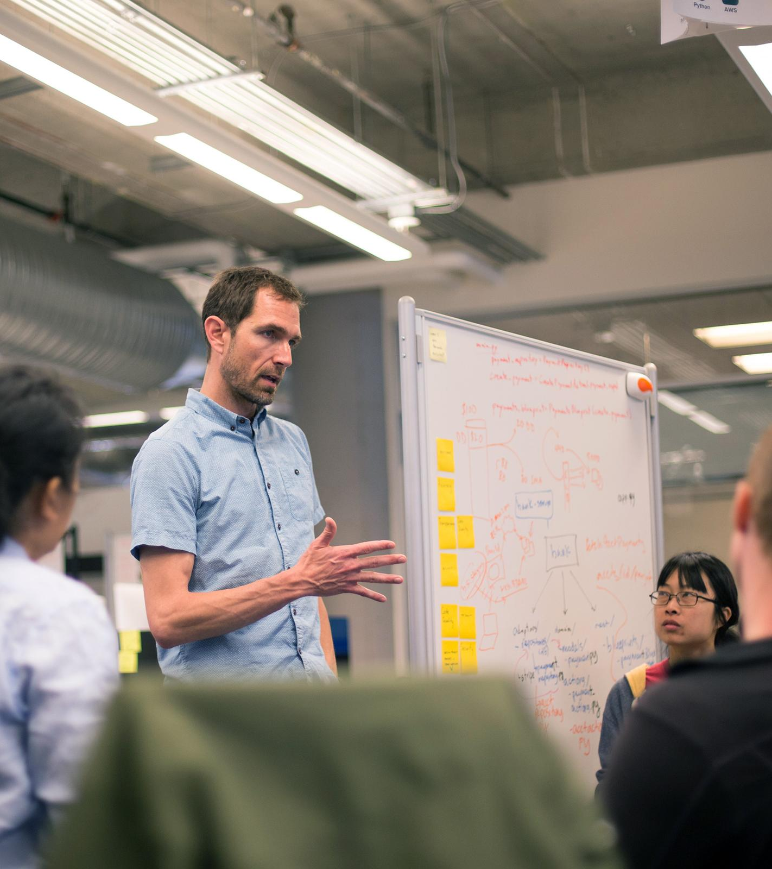
Topics
Introduction
Platforms
k8s (PKS) vs PCF
Spring Boot + Spring Cloud
What runtime to pick? Future?
Pivotal Cloud Foundry
Q&A

Slide 3
Introduction
So what’s this about?

Slide 4
About me
Lars Rosenquist
Platform Architect at Pivotal
Field organisation
Helping companies become great software companies
Developing software professionally since 1998
Financial, governmental, commercial
Java, Spring, Cloud Foundry
Twitter: @larsrosenquist
Email: lrosenquist@pivotal.io

Slide 5
Platforms
Which platform for which workloads

Slide 6
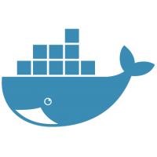
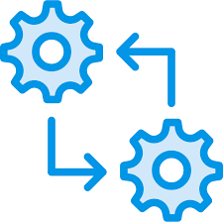
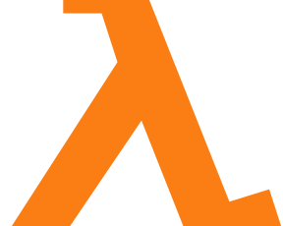

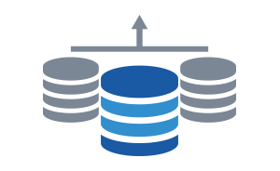

Companies have many ways to package and run their workloads in the cloud
CONTAINERS
Batches
EVENT-DRIVEN FUNCTIONS
MICROSERVICES
MONOLITHIC APPLICATIONS
DATA SERVICES
Notes:
By making the first task on any software effort “delivery” - deploy the code somewhere, even if it doesn’t do anything.
And then keep doing that every time you change anything…

Slide 7
Pick the right runtime for each workload
CONTAINERS
Batches
EVENT-DRIVEN FUNCTIONS
MICROSERVICES
DATA SERVICES
MONOLITHIC APPLICATIONS
Container
Orchestrator (CaaS)
Application Platform
(PaaS)
Serverless Functions
(FaaS)
IaaS
Notes:
By making the first task on any software effort “delivery” - deploy the code somewhere, even if it doesn’t do anything.
And then keep doing that every time you change anything…

Slide 8
Choose the right tool for the job
Container
Orchestrator
Application Platform
Serverless Functions
Developer
Provides
CONTAINER
APPLICATION
FUNCTION
Tool
Provides
Container Scheduling
Primitives for Network, Routing, Logs & Metrics
Container Orchestrator
Application Platform
Container Image & build
L7 Network & Routing
Logs, Metrics, Monitoring
Services Marketplace
Team, Quotas & Usage
Container Orchestrator
Function scheduling
Function exec services
IaaS

Slide 9
Choose the right tool for the job
Container
Orchestrator
Application Platform
Serverless Functions
Developer
Provides
CONTAINER
APPLICATION
FUNCTION
Tool
Provides
Container Scheduling
Primitives for Network, Routing, Logs & Metrics
Container Orchestrator
Application Platform
Lower complexity, higher efficiency
Container Image & build
L7 Network & Routing
Logs, Metrics, Monitoring
Services Marketplace
Team, Quotas & Usage
Container Orchestrator
Higher flexibility, lower standardization
Function scheduling
Function exec services
IaaS

Slide 10
Serverless Functions
Application Platform
Higher flexibility and less enforcement of standards
Lower development complexity and higher operational efficiency
Container Orchestrator
IaaS
Hardware
Strategic goal: Push as many workloads as technically feasible to the top of the platform hierarchy

Slide 11
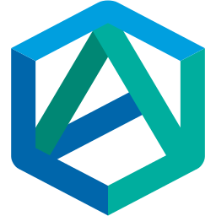
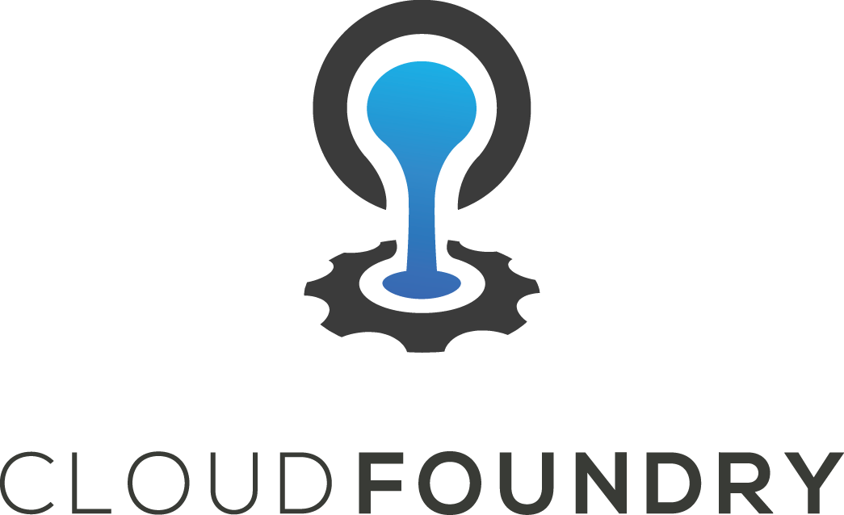
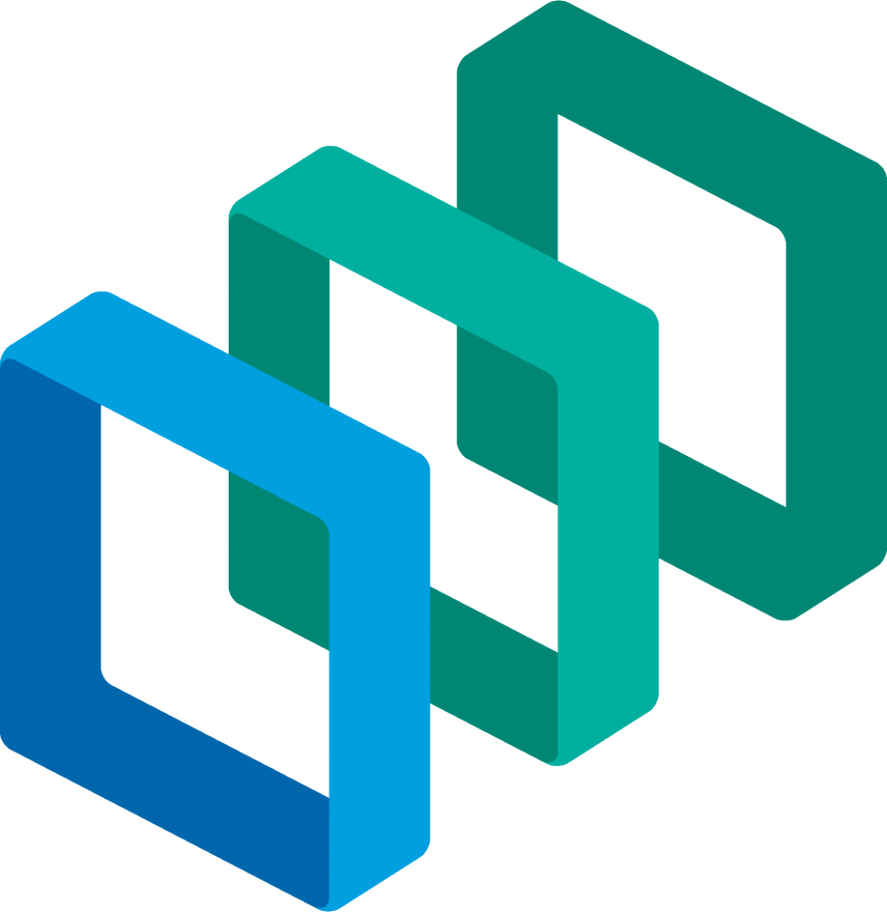
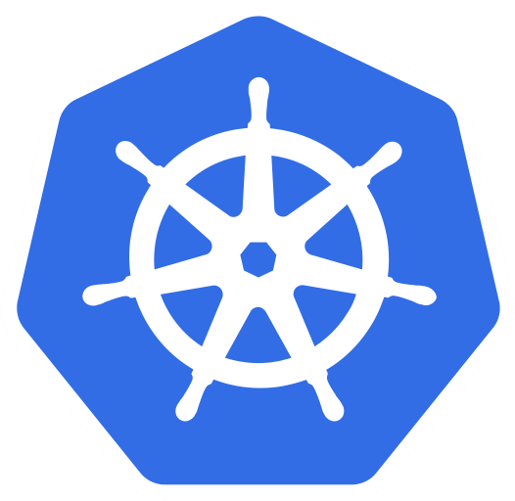
Application runtime <-> Container runtime
Which platform for which workloads

Slide 12
Setup
Cloud foundry
Pivotal Cloud Foundry
Running on GCP
OS Cloud Foundry + extras (marketplace)
Deployment shown here will work on any CF flavor
Kubernetes
Pivotal Container Service
Running on GCP
Vanilla k8s + extra (management layer)
Deployment shown here will work on any k8s flavor

Slide 13
Application: Fortune teller
Simple, multi-tiered Spring Boot application
Fortune Service - REST endpoint
Uses a database, or in-memory if none available
Uses service registry
Fortune Teller UI - Web app
Uses Fortune Service
Uses service registry
Uses circuit breaker
Uses config server
GITHUB: https://github.com/NLxAROSA/fortune-teller
UI
Config
server
Service
Service
registry
MySQL

Slide 14
Application: Fortune Teller
Stack
Spring Boot
Spring Cloud
Netflix
Circuit breaker (Hystrix)
Service Registry (Eureka)
Spring Cloud Config
Spring Cloud Services connectors for CF
Spring Data JPA

Slide 15
Building and deploying an application
Cloud Foundry
mvn clean package
Create/edit manifest.yml
cf push
Kubernetes
mvn clean package
Create/edit Dockerfile
mvn dockerfile:push
Create/edit deployment and service ymls
kubectl create -f deployment.yml
kubectl create -f service.yml

Slide 16
Viewing application logs
Cloud Foundry
cf logs fortune-service --recent
cf logs fortune-ui --recent
Aggregated, streamed to firehose
Basic options (for extended options use the firehose and a logging solution like Splunk, ELK, etc.)
Kubernetes
kubectl get po
kubectl logs <podname> -f
Not aggregated
More flexible options, like tailing, since, timestamps, etc.

Slide 17
Distributed tracing
Cloud Foundry
Zipkin tracing built-in GoRouters
Can be enabled/disabled via Ops Manager
Spring Cloud Sleuth makes it easy to add tracing information to logs
CF integrates all logs into single stream
Kubernetes
Not trivial out of the box
Experience depends on the tool used (e.g. StackDriver trace or Zipkin-proxy containers
Other ways to enable Zipkin
But do we really expect this from a container runtime vs a full blown platform?

Slide 18
Connecting to a database
Cloud Foundry
Database available via marketplace
Implementation depends on vendor
User experience should be similar
cf create-service p-mysql 100mb fortunes-db
Bind to application either by:
cf bind-service fortune-service p-mysql
Add to manifest.yml
No config to maintain for developer
Allows cool stuff like credential rotation
Kubernetes
Create yourself
Create your own pod/cluster
Use a Helm chart
Use Open Service Broker API when available
kubectl create -f database.yml
No binding (just point to it via deployment.yml)
Harder/more to maintain
No automated capabilities in the platform (yet)

Slide 19
SSH into running application
Cloud Foundry
cf ssh fortune-service -i 0
Kubernetes
kubectl get po
kubectl exec -it <podname> -- /bin/bash

Slide 20
Developer experience summary
Cloud Foundry
Little overhead/less verbose
Specify app
Specify dependencies
Platform handles for you
Routing
Port mappings
Load balancing
Kubernetes
More overhead/verbose
Specify app/container
Specify dependencies
You specify
Routing
Port mapping
Load balancing
Big ball o’yaml
Reminds of Spring XML config era
Not platform by itself, snowflake pitfall

Slide 21
Regardless of differences
Both experiences
Both experiences are miles ahead of deploying straight to IAAS or bare metal
Standardized ways of configuration and deployment
Higher level of standardization = higher level of automation = faster time to market
Both assume infrastructure is managed
Explicitly in CF (BOSH)
Implicitly on k8s (depending on vendor)
Less time spent on ops = faster time to market

Slide 22
Cloud Foundry or Kubernetes?
How to pick where to deploy what workload?

Slide 23
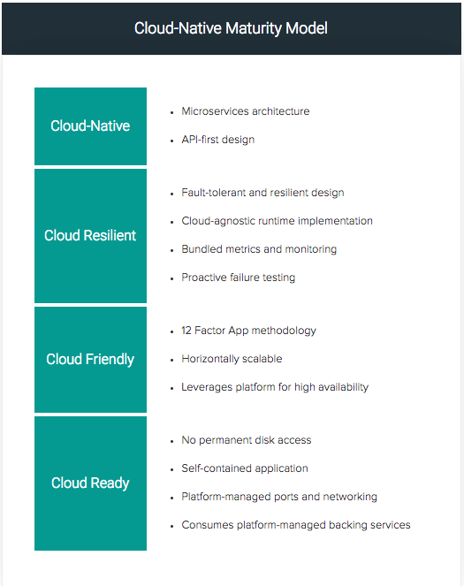
How to decide where to deploy workloads?
CF Benefit: Lower development complexity
Run on Pivotal Application Service (CF)
YES
Is the application cloud ready?
CUSTOM
Run on VM
NO
YES
What kind of application is this?
NO
Is the application worth refactoring?
NO
Can you build a docker container?
NO
COTS
NO
YES
Do you need low level control?
Do you have a docker container?
YES
YES
Run on Pivotal Container Service (K8s)
K8s Benefit: Run any non-cloud native applications

Slide 24
So what about the future?
CAAS, PAAS, FAAS, ?

Slide 25
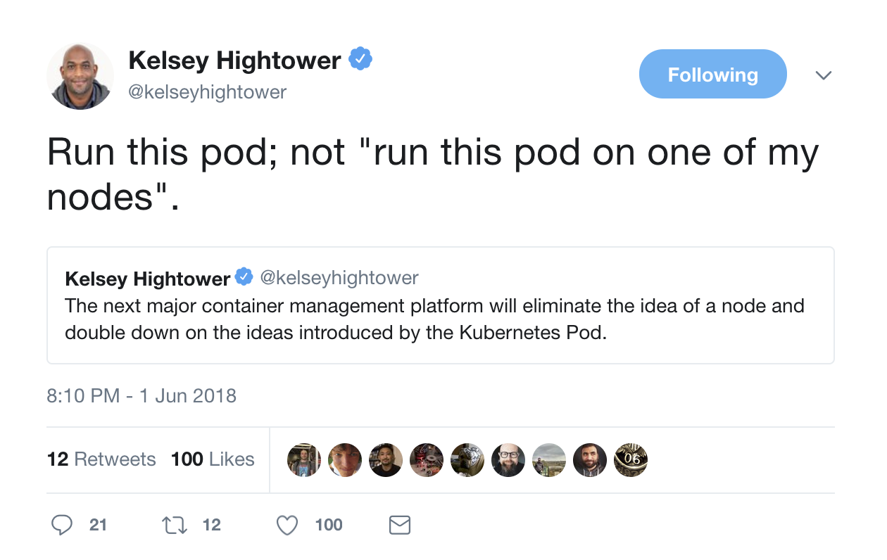
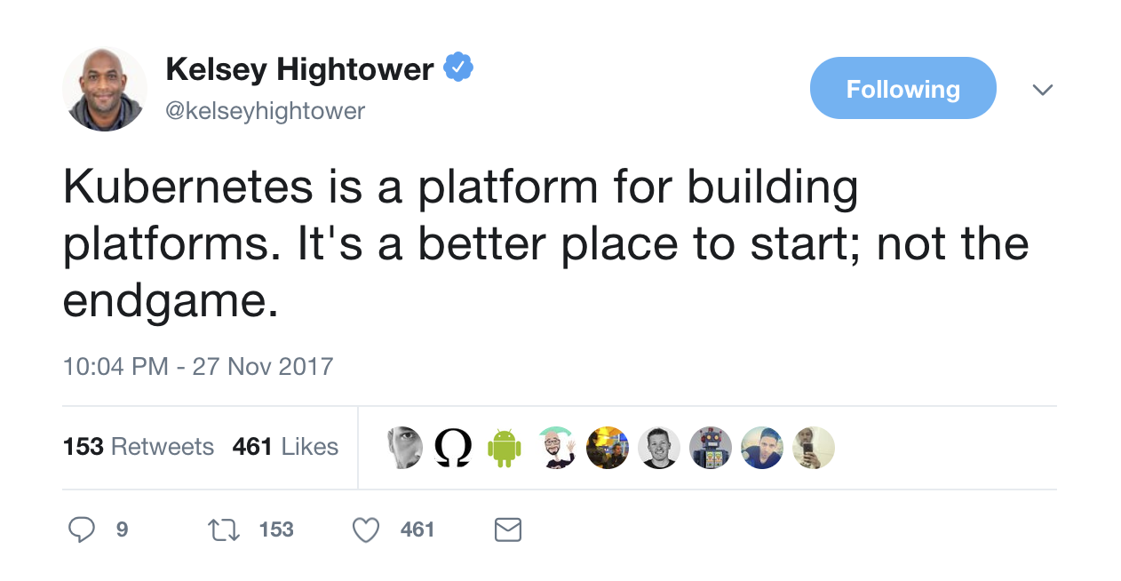
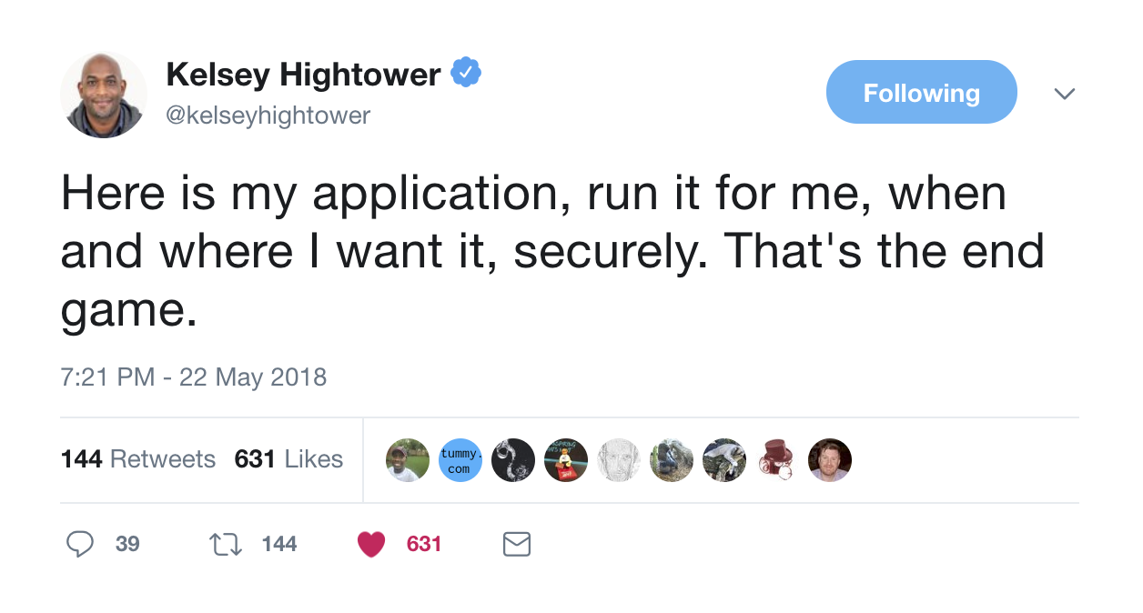
Some tweets to consider

Slide 26
Pivotal Cloud Foundry
Short commercial break

Slide 27
Application Code & Frameworks
Buildpacks / Spring Boot / Spring Cloud / Steeltoe
PAS
Pivotal Application Service
PKS
Pivotal Container Service
PFS
Pivotal Function Service
Pivotal Services Marketplace
Pivotal and
Partner Products
Shared Services
Logging & Metrics / Services Brokers / API Management
Shared Security
Credhub / UAA / Single Sign On
Shared Networking
VMWare NSX
Concourse
Embedded Operating System (Windows / Linux)
vSphere
Openstack
AWS
Google Cloud
Azure & Azure Stack

Slide 28
Benefits of PCF
Spring Boot apps integration with AppsManager
Spring deployment profiles (“cloud” profile)
Spring Cloud Connector for Cloud Foundry (VCAP_SERVICES, VCAP_APPLICATION)
Java Buildpack
Advanced JVM memory calculator
JVM heap dump histograms
3rd party framework integration (APM)
Self-executable JARs
Spring Security integration with CF SSO
Spring integration with CredHub
Spring Cloud Services
Config Server, Service Registry, Circuit Breaker Dashboard
Spring Cloud Pipelines
Spring Cloud Dataflow for PCF
PCF Metrics

Slide 29
Q&A

Slide 30
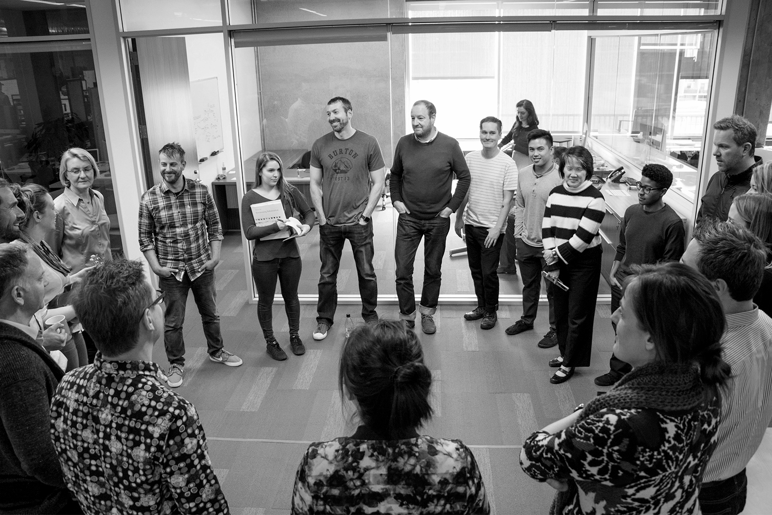
Transforming How The World Builds Software
© Copyright 2018 Pivotal Software, Inc. All rights Reserved.

